Slide 1
The Appearance of the
ORAL CAVITY
DR. RAFEY AHMAD JAMEEL
BDS, MDSc (Malaysia)

Slide 2
ORAL CAVITY (MOUTH)
LIPS
PILLARS OF FAUCES (ANTERIOR/ POSTERIOR)
PALATE (HARD/ SOFT)
TONGUE
FLOOR OF THE MOUTH
CHEEKS
RETROMOLAR PAD AREA
TEETH

Slide 3
SIGNIFICANCE
USE OF COORRECT AND APPROPRIATE TERMINOLOGIES.
KNOW THE NORMAL, TO APPRECIATE THE ABNORMAL.

Slide 4
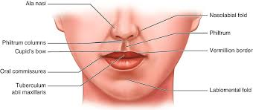
LIPS

Slide 5
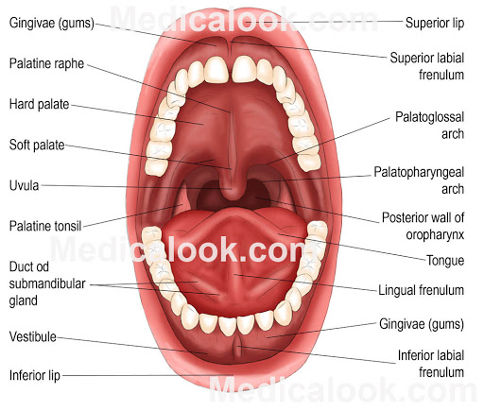
ORAL VESTIBULE

Slide 6
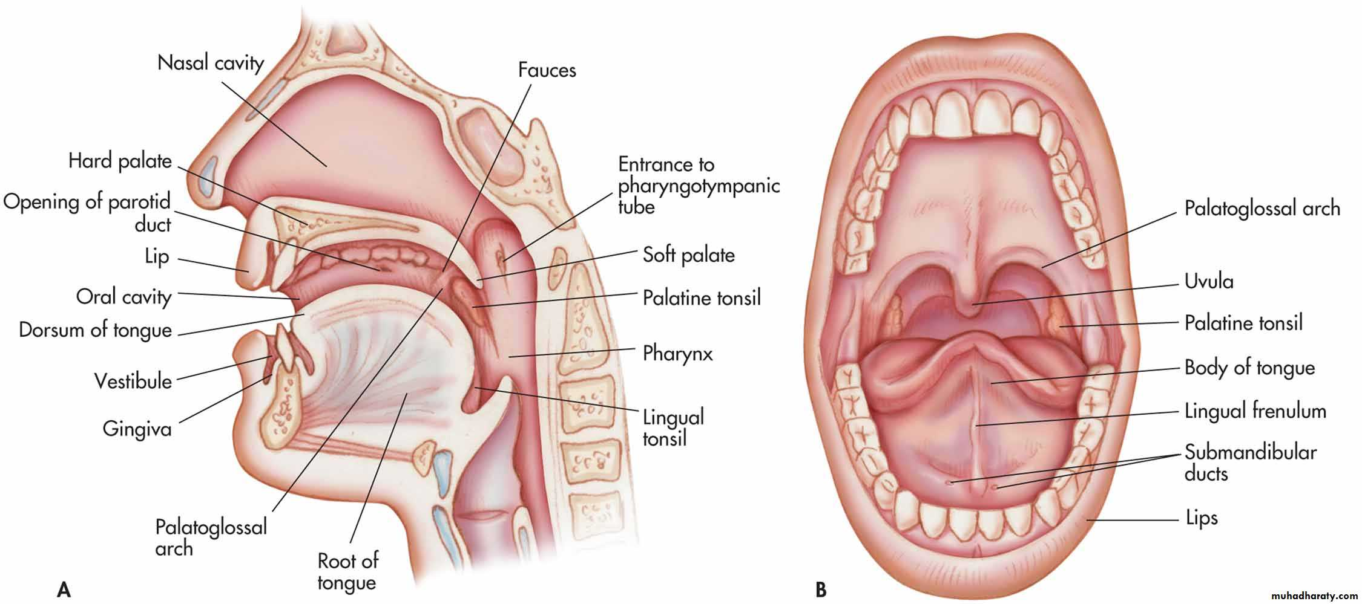

Slide 7
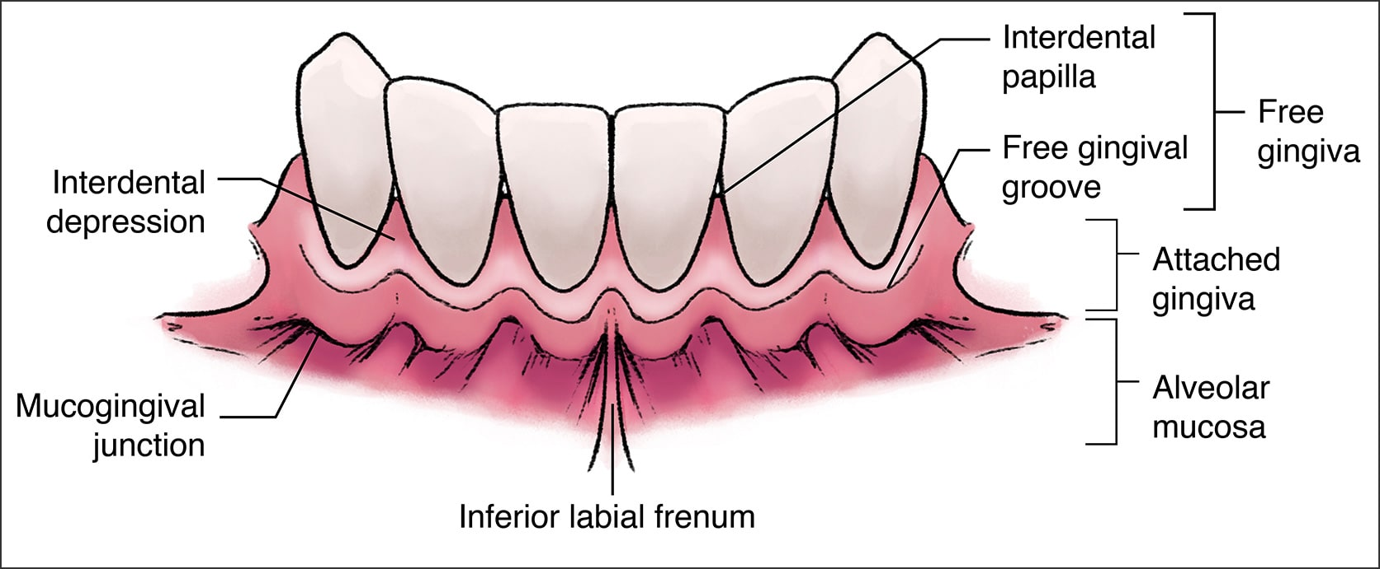
GINGIVA

Slide 8
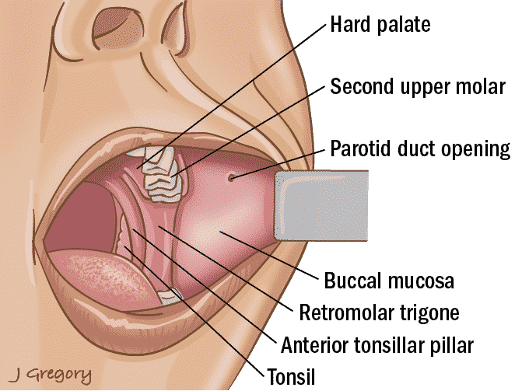
CHEEKS

Slide 9
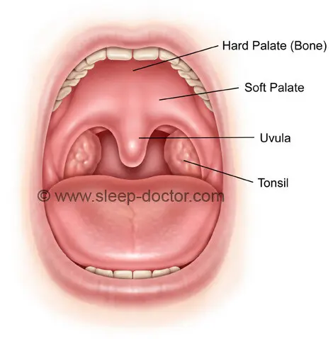
PALATE

Slide 10
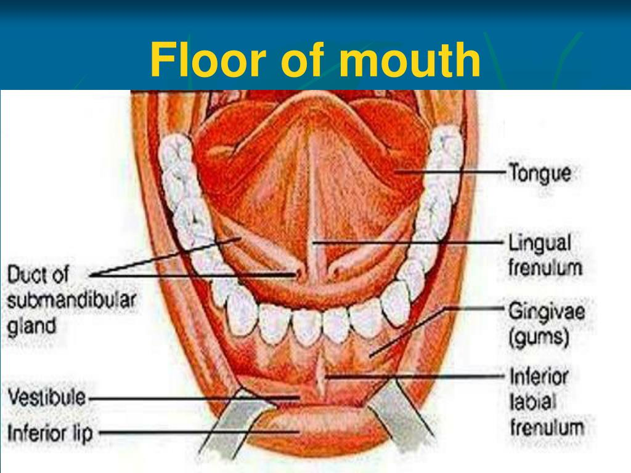
FLOOR OF THE MOUTH

Slide 11
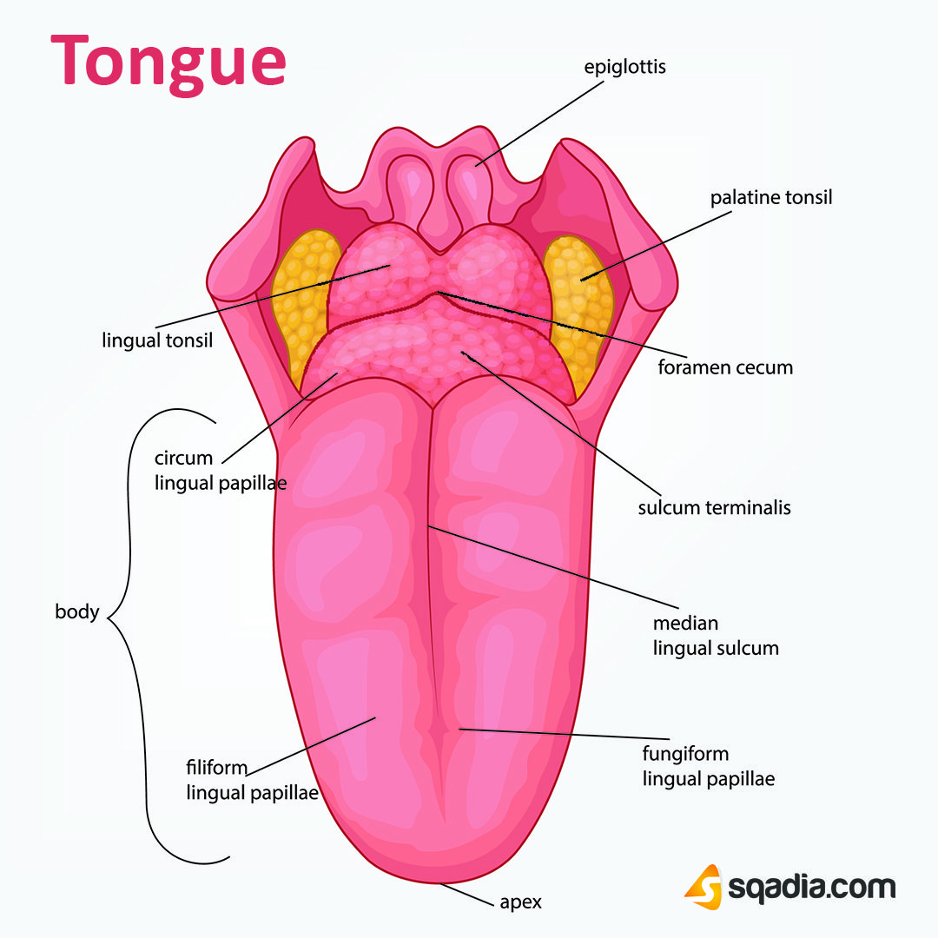
TONGUE

Slide 12
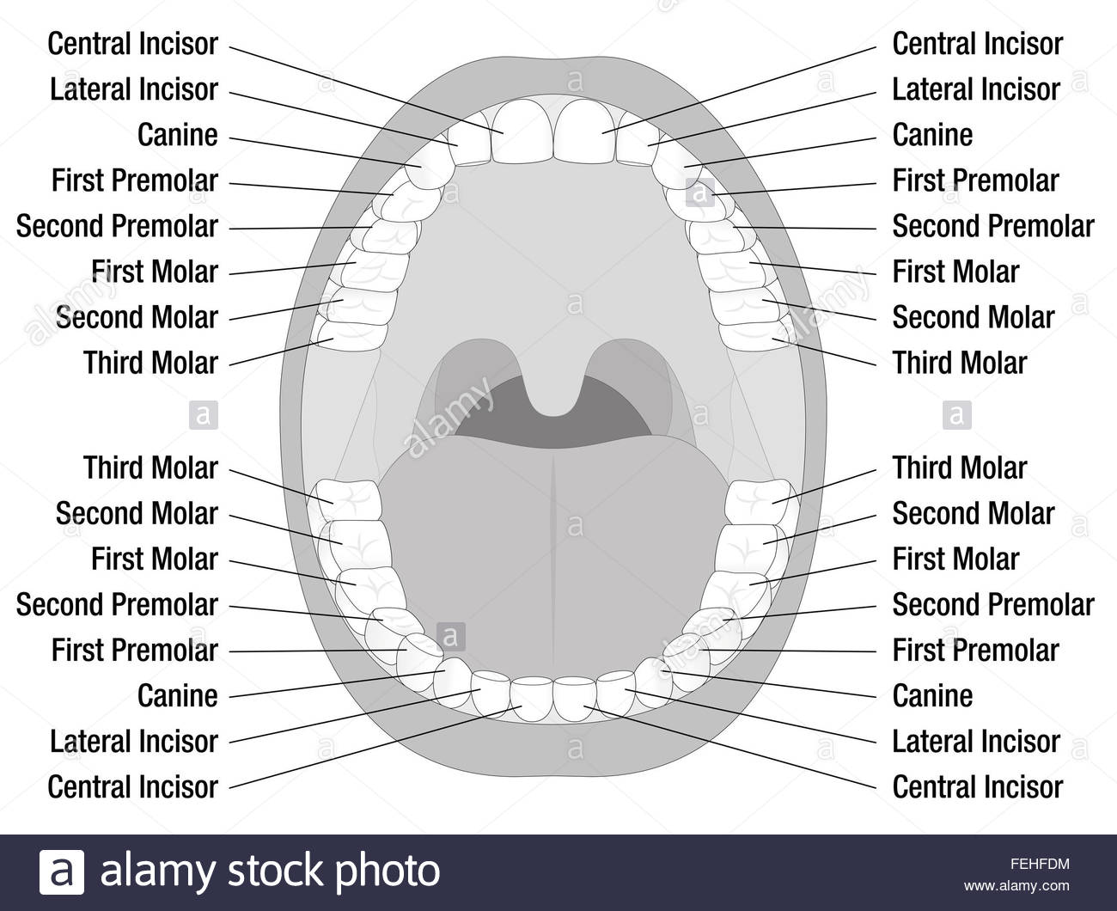
TEETH

Slide 13
CLINICAL CONSIDERATIONS
Pigmentation Variations
  Black Hairy Tongue
  Fordyce Spots
  Lichen Planus
Benign Disorders
  Linea Alba
  Tori (Torus Mandibularis/ Torus Palatinus)
  Smoker’s Keratosis

